Slide 1



Offuture Project
Vedi
Hari
Huss
Joseph

Slide 2
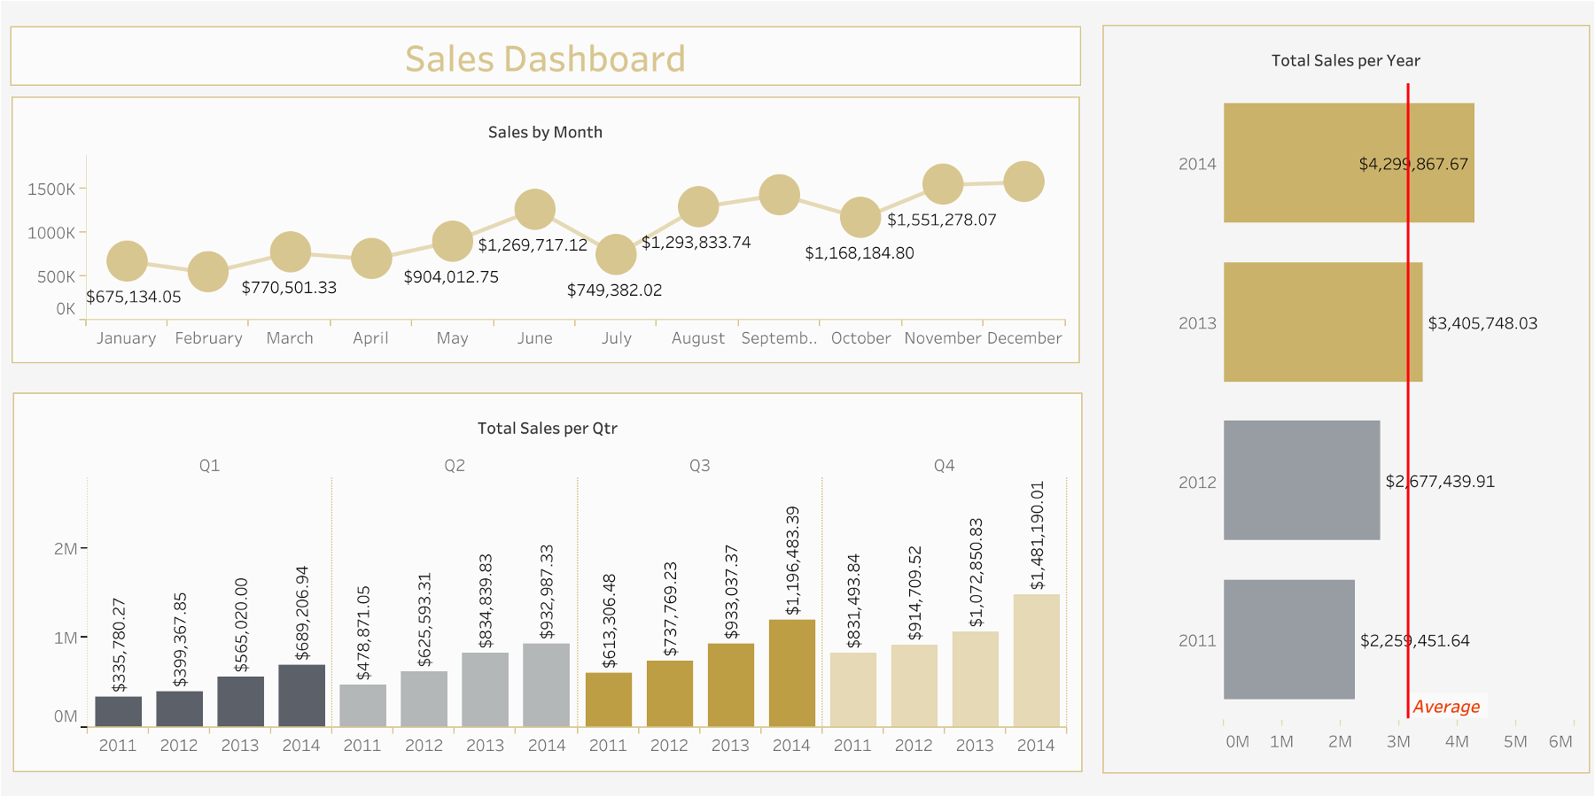

Slide 3
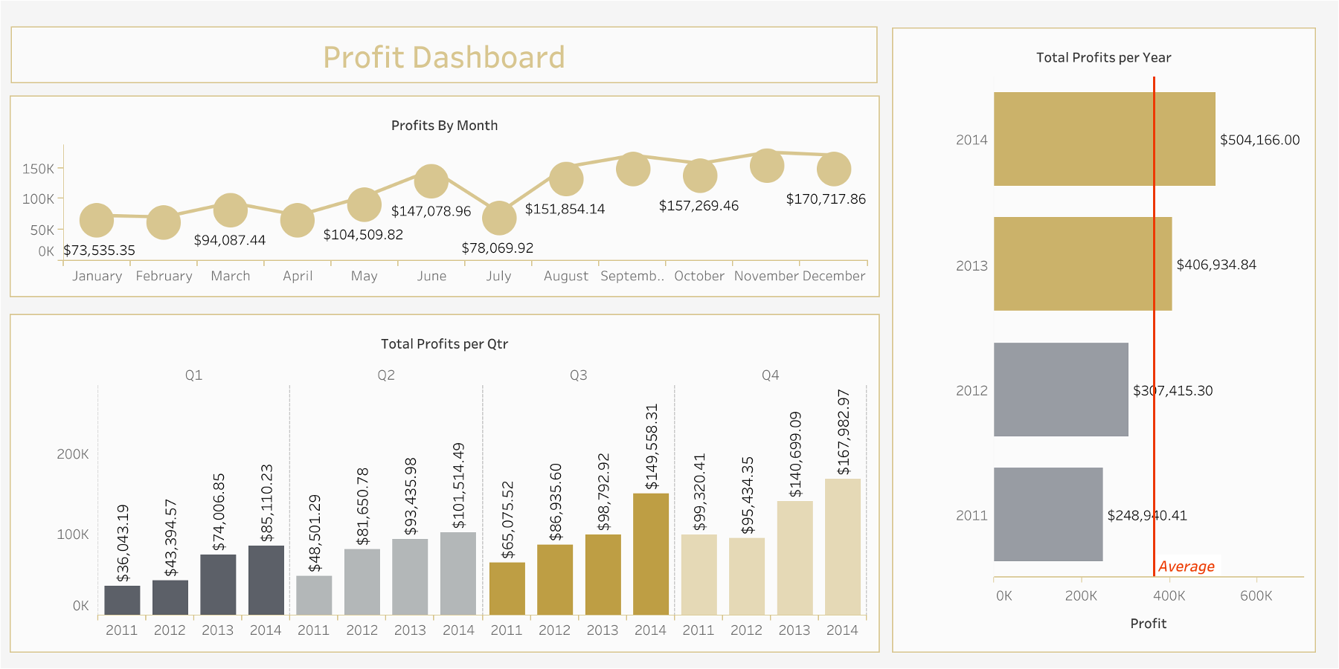

Slide 4
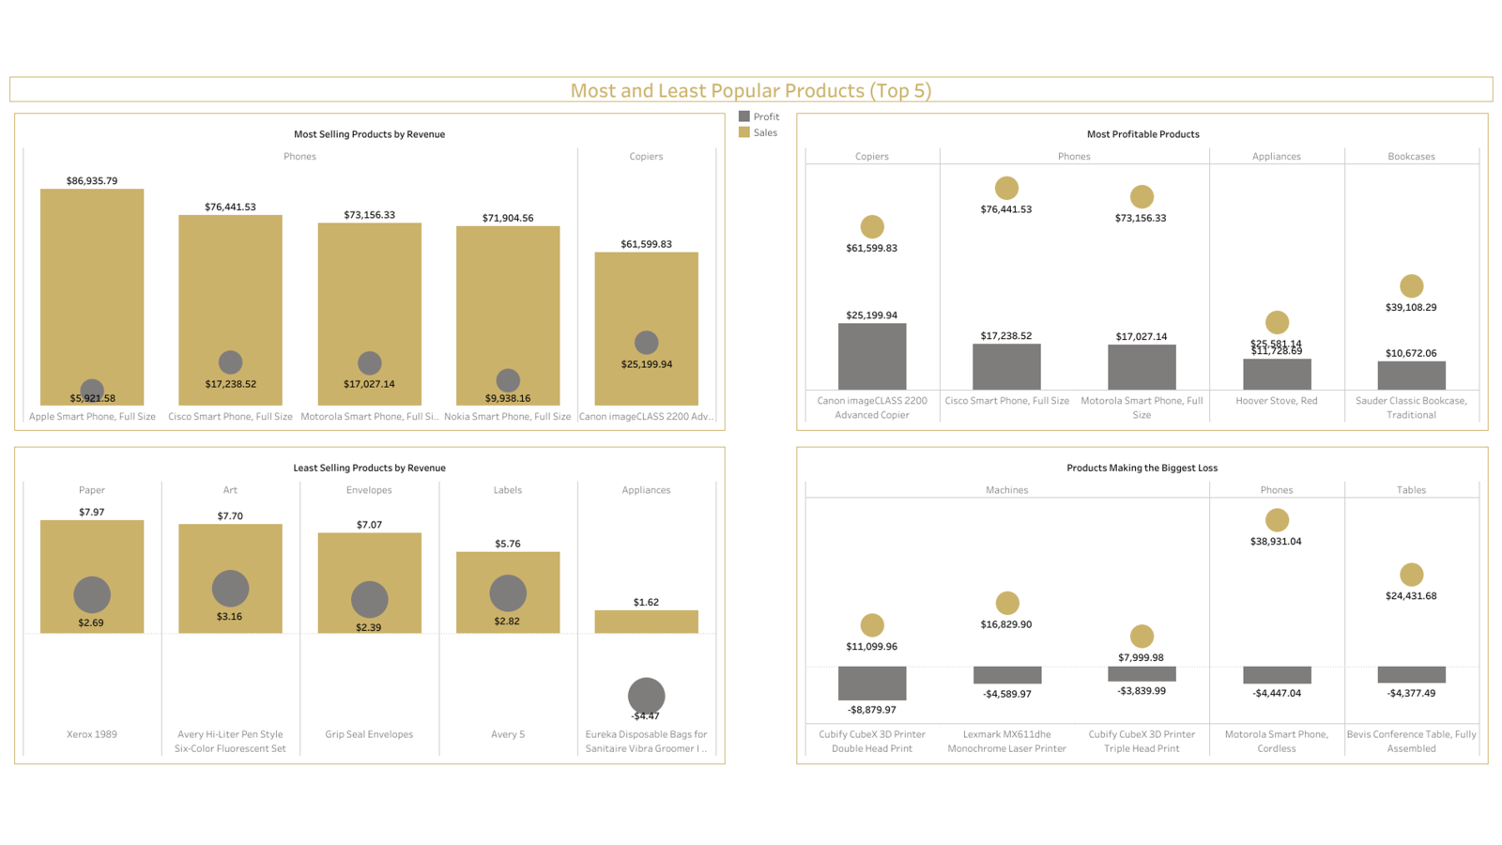

Slide 5
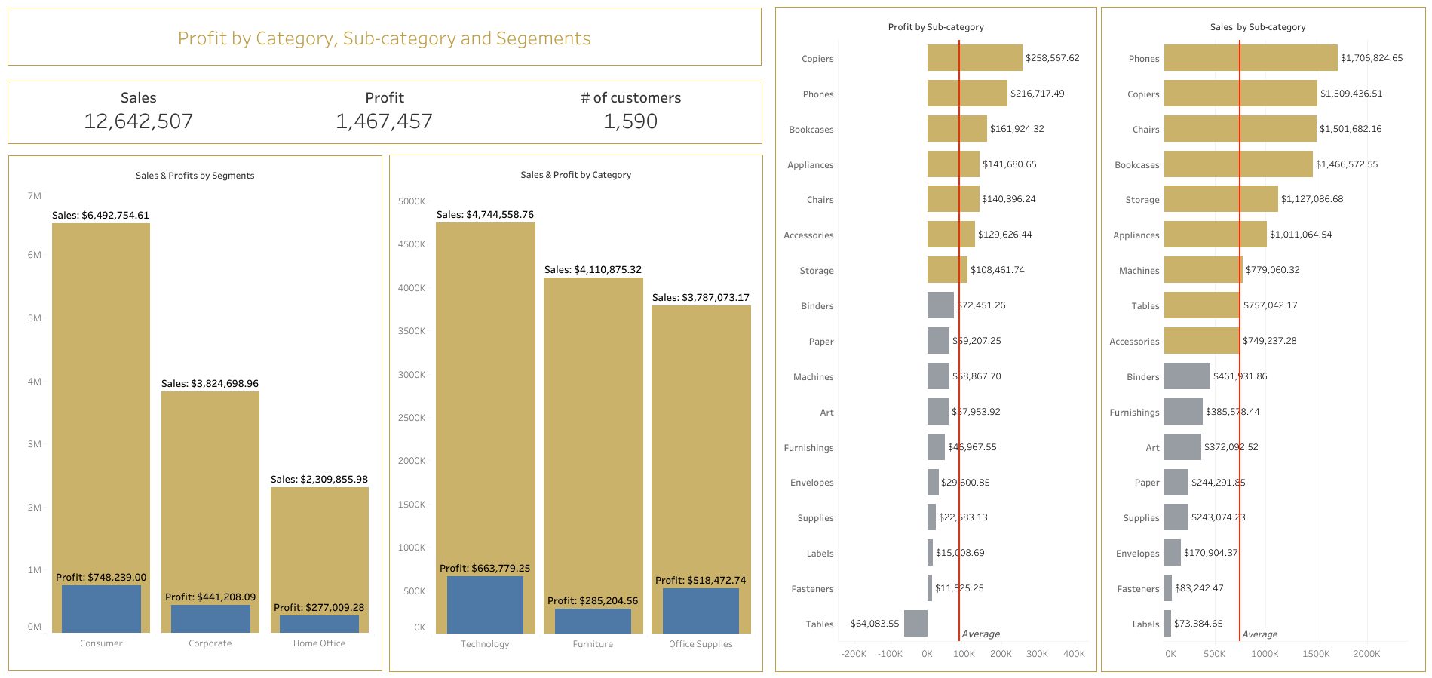

Slide 6
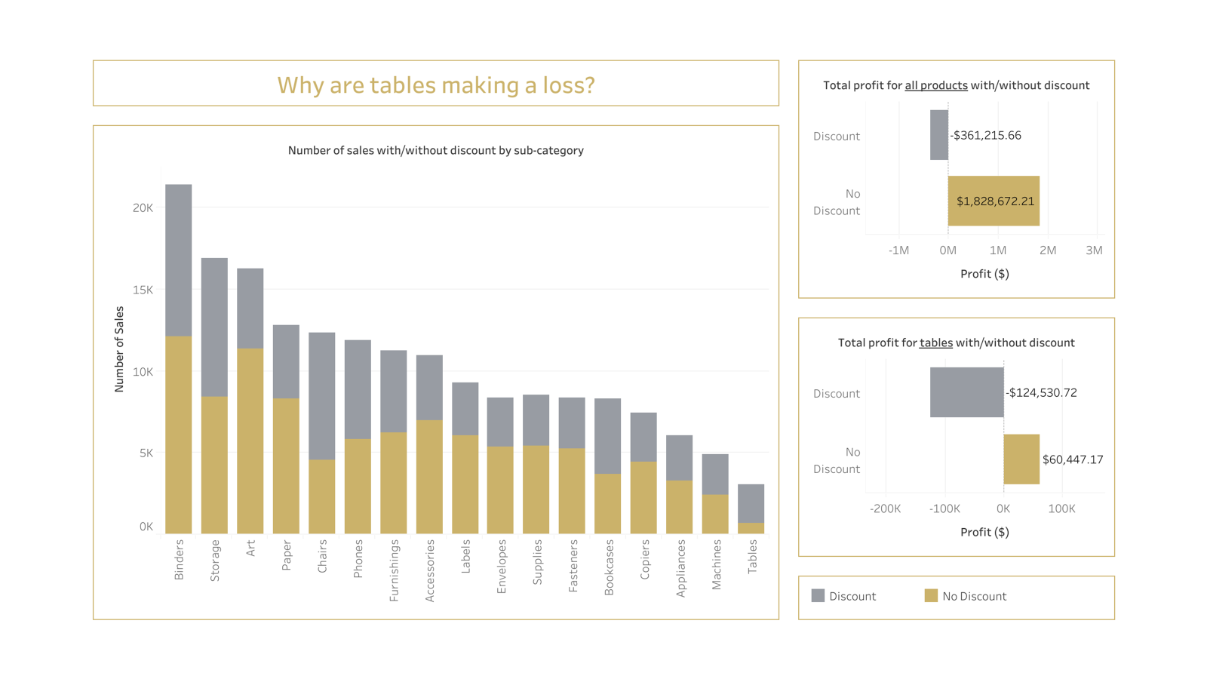

Slide 7
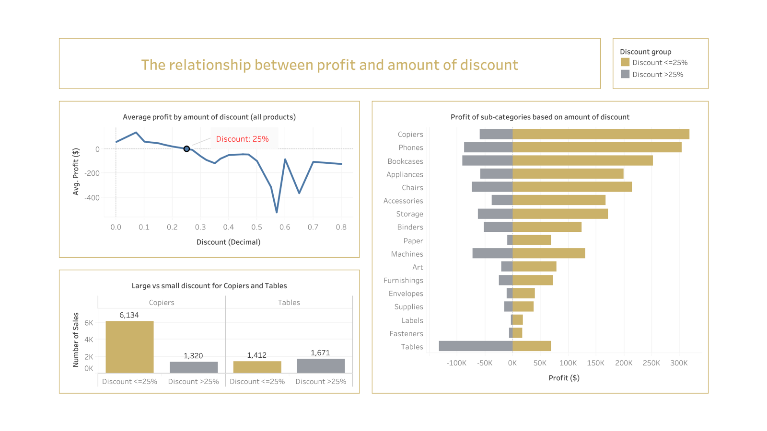

Slide 8

Thank you for your time
Do you have any questions?

